Slide 1
Lesson 1:Installation Steps
Javan Juma

Slide 2
ADVENTUREWORKS DATABASE
For this class, we will use a pre-existing database for learning reasons.
We are going to download AdventureWorks database and import necessary objects for learning purposes.
In the later part of the class, we will be able to create our own database and do some management operations.
Why this particular database? It has a lot of details/large enough/extensive/well referenced/ myriad of examples.
AdventureWorks sample databases - SQL Server | Microsoft Learn

Slide 3
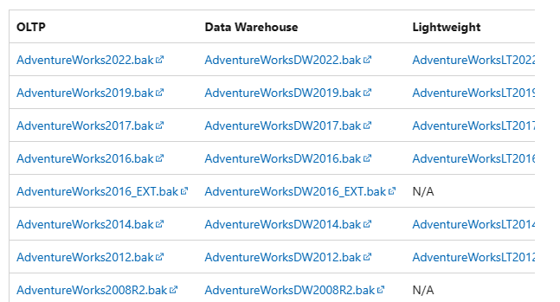
ADVENTUREWORKS DATABASE CNT’D…
To import the database, go to GOOGLE and search “download AdventureWorks sample database”.
Click on the first link.

Slide 4
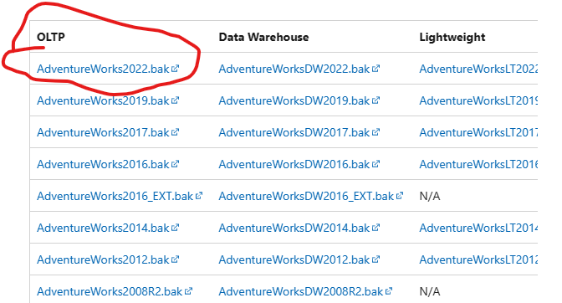
ADVENTUREWORKS DATABASE CNT’D…
Click on the first link under “OLTP”. The file will be downloaded. Should be the 2022 version of the AdventureWorks database as a .bak extension.
It is around 200mbs. Copy the file and put it to the folder we created during installation.
In addition, go to your C Drive under programs, there is another MSSQL flder that was created by the system, you should copy the database to that folder too.

Slide 5
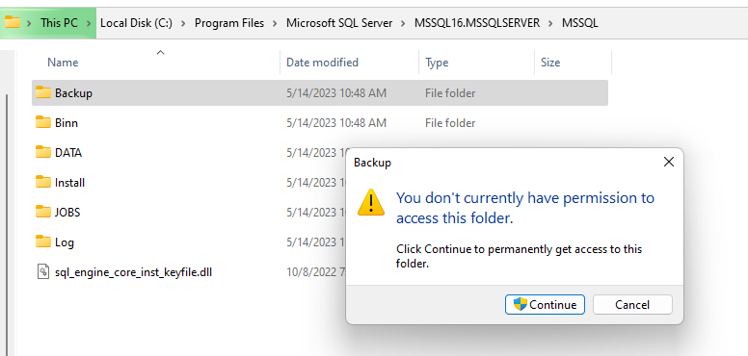
ADVENTUREWORKS DATABASE CNT’D…
The image to the right shows the steps to reaching the backup folder for which you are expected to make the pasting of the AdventurerWorks file.

Slide 6
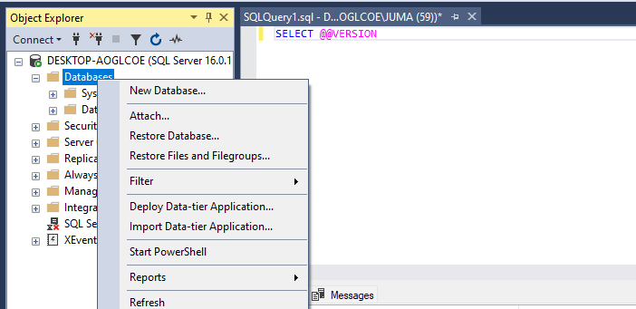
CONNECT TO THE ADVENTUREWORKS DATABASE
Go back to SSMS, Right-click on “database”, then “restore database”, then check “Device”,

Slide 7
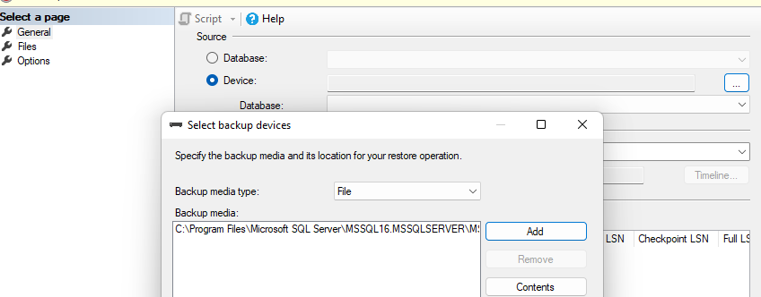
CONNECT TO THE ADVENTUREWORKS DATABASE
and on the ellipsis/three dots, click to access another pop-up. Click “Add” and choose Adventure works. You are good to go!
In case you do not see the file, just refresh.

Slide 8
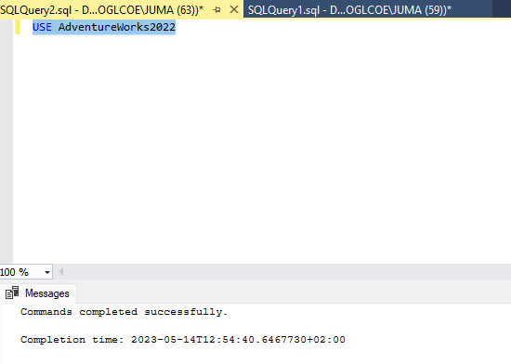
USE ADVENTUREWORKS2022
Click “New Query” on the ribbon. Ensure you are on “AdventureWorks2022 by writing the following code:
USE AdventureWorks2022

Slide 9
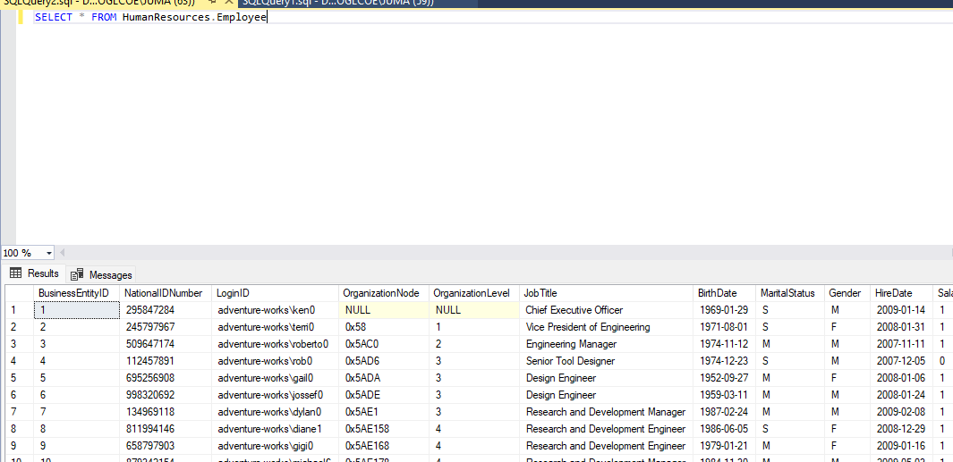
SELECT ALL(*) FROM SCHEMA_NAME.TABLE_NAME
SELECT * FROM HumanResources.Employee

